Slide 1

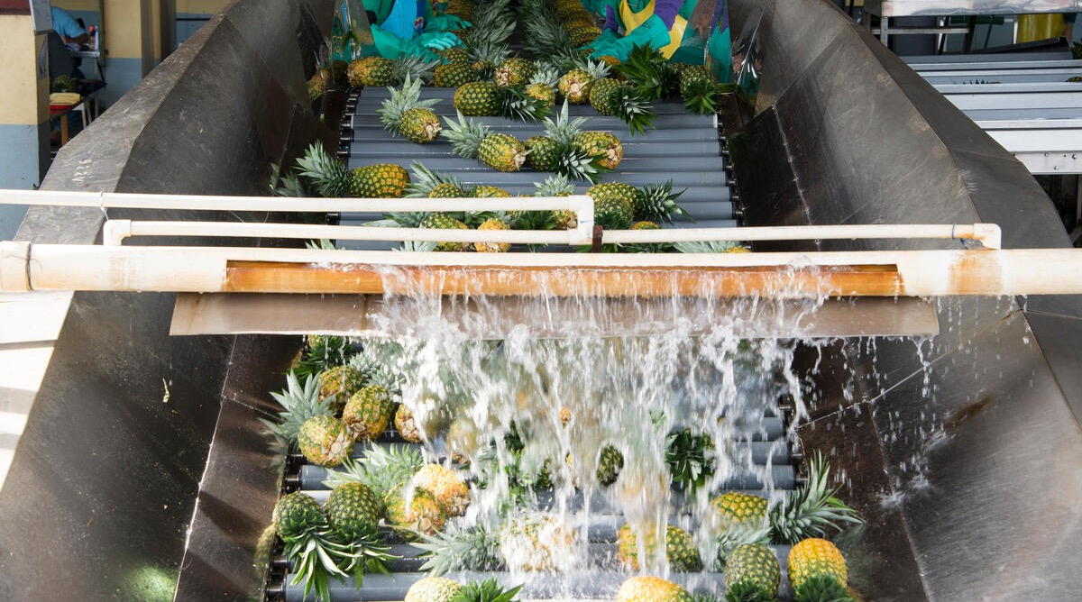

Water footprint measurement in pineapple value chains

Slide 2


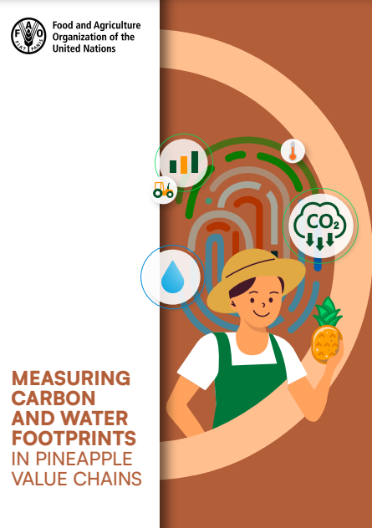


Objectives:
To introduce companies in the pineapple value chain to a method for measuring water footprints based on the FAO technical guide “Measuring carbon and water footprints in pineapple value chains”.
To build the capacity of individuals and organizations to make their own water footprint calculations independently.
The technical guide is available at: https://doi.org/10.4060/cd1688en

Slide 3
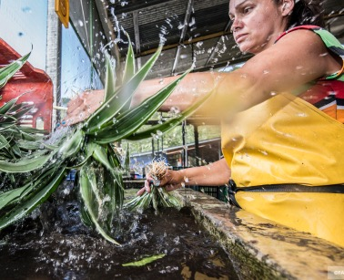
Acknowledgements:
The slide content was prepared by Gestarse for FAO.
This work has been made possible by support from the Government of Germany.

Slide 4

Contents of this course: How is a water footprint calculated?
1
General water footprint calculation
Scope of the water footprint
Identification of water balance and use of products
Assessment of water footprint impact
Water footprint report
Water footprint reduction measures
2
3
4
5
6

Slide 5
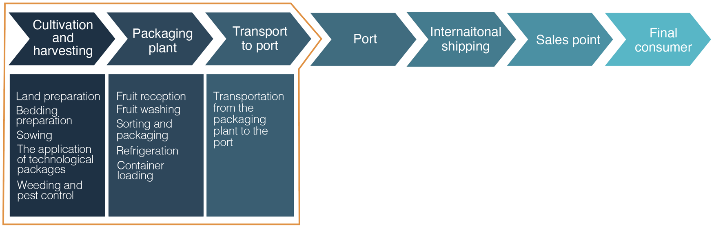
Processes considered within the scope of the water footprint measurement guide:
General water footprint calculation
Processes outside the scope of the guide
Processes included

Slide 6
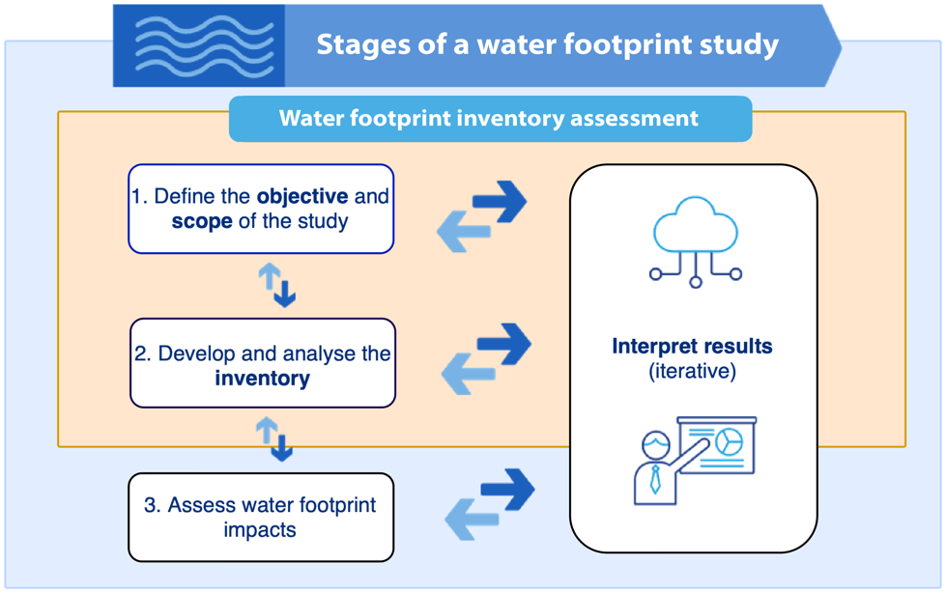
Recommended steps for the water footprint study:
General water footprint calculation (continued)
Source: Adapted from ISO (International Organization for Standardization) . 2014. International standard ISO 14046:2014(E): Environmental management — Water footprint — Principles, requirements and guidelines.

Slide 7




Water footprint:
General water footprint calculation (continued)
Basic concepts
Direct water usage:
Water use related to human activities:
Metric(s) that quantifies the potential environmental impacts related to water.
Usage that take place during day-to-day operations within the company’s facilities
Any form of withdrawal or release of water, or its use within the same watershed, that affects water quantity or quality.

Slide 8
Basic concepts
Consumption or consumptive use
Degradation or degradative use
corresponds to
corresponds to
Water that was used by the organization, and as a result did not return to the same watershed from which it was extracted.
Activities that can potentially affect or worsen the water quality.
for example:
for example:
Water that is lost through evaporation, evapotranspiration or discharge to a different watershed.
Application of products to soil and air that may reach water sources, or application of these products directly to water that may affect water quality
Impact category:
Impact category:
Shortage
Eutrophication in fresh & salt water
Ecotoxicity and Human toxicity

Slide 9
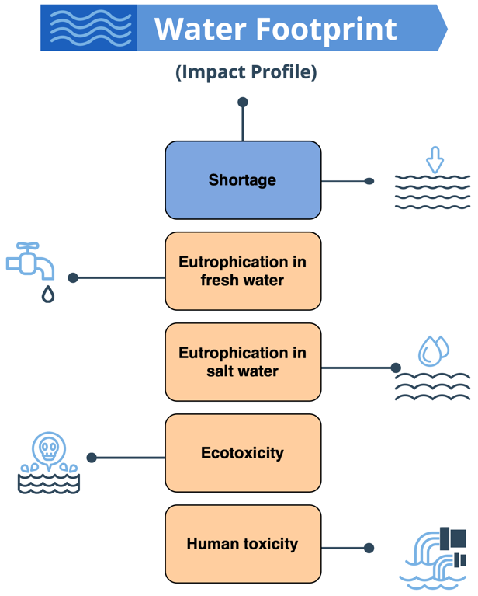
Impact category:
Basic concepts
This classification is given to an aspect that represents an environmental importance related to the usage of water in the productive activities of the sector.

Slide 10
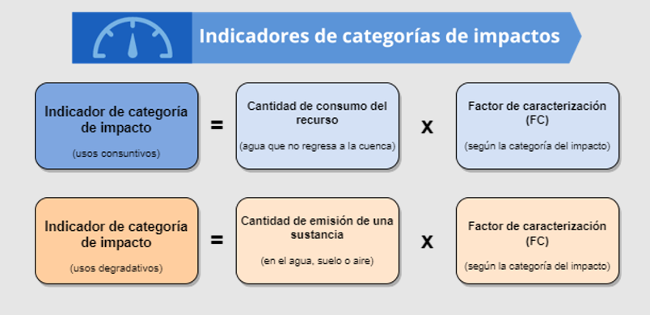
Impact category indicator:
Basic concepts
Impact category indicators
This indicator corresponds to the numerical value of each impacted estimate. This is achieved by multiplying the water consumption or quantity of a substance emitted, as appropriate, with a value known as the characterization factor (CF).
Impact category indicator
(consumptive uses)
Amount of resource consumption
(water that does not return to the basin)
Characterization factor (CF)
(according to impact category)
Impact category indicator
(degrading uses)
Amount of emission of a substance
(in water, soil or air)
Characterization factor (CF)
(according to impact category)

Slide 11
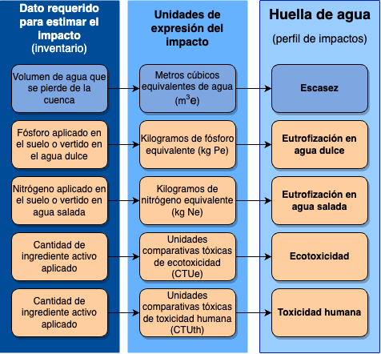
Basic concepts
Data needed to estimate impacts (inventory)
Impact expression units
Water footprint (impact profile)
The information collected should correspond to the year of study defined within the scope. The data required will be associated with the impacts to be estimated.
Volume of water lost from the watershed
Cubic meters of water equivalent (m3e)
Shortage
Phosphorus applied to soil or discharged into freshwater
Kilograms of phosphorus equivalent (kg Pe)
Freshwater eutrophication
Nitrogen applied to soil or discharged into salt water
Kilograms of nitrogen equivalent (kg Ne)
Saltwater eutrophication
Quantity of active amount applied
Comparative toxic ecotoxicity units (CTUe)
Ecotoxicity
Quantity of active ingredient applied
Comparative toxic units of human toxicity (CTUth)
Écotoxicité
Human toxicity

Slide 12
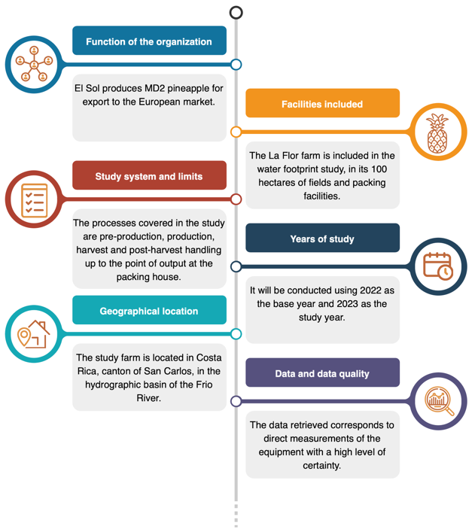
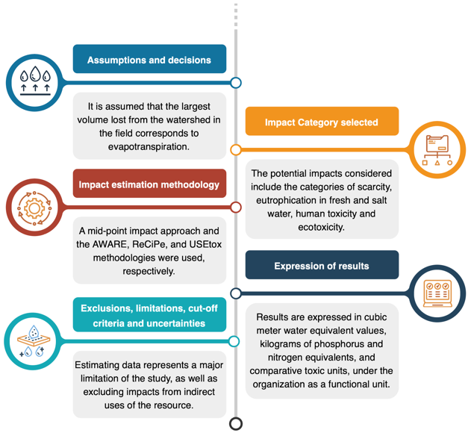
Scope of the water footprint

Slide 13
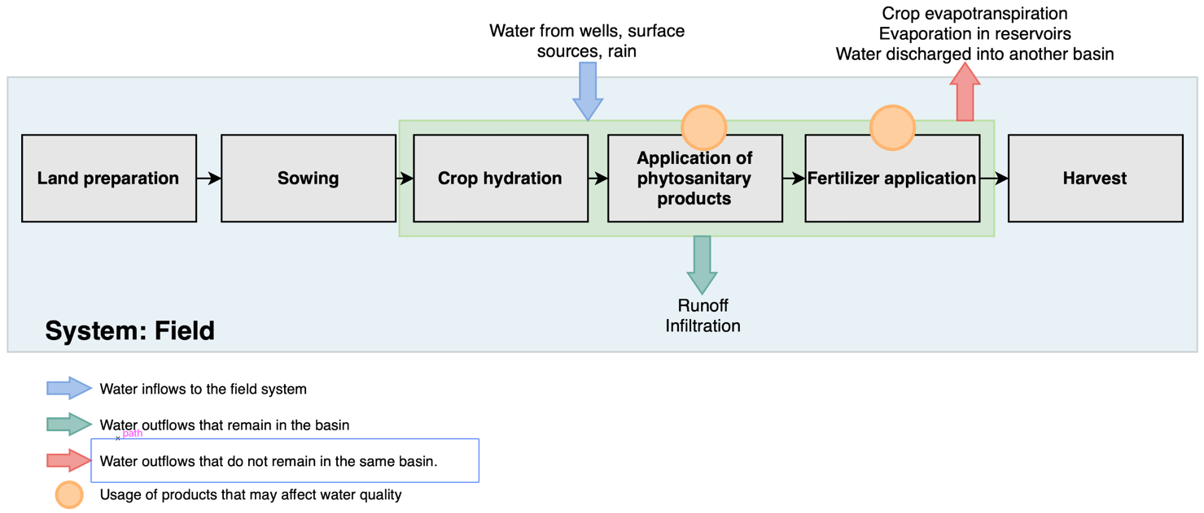
Identification of water balance and use of products
Identification of water balance and use of products at the field stage

Slide 14
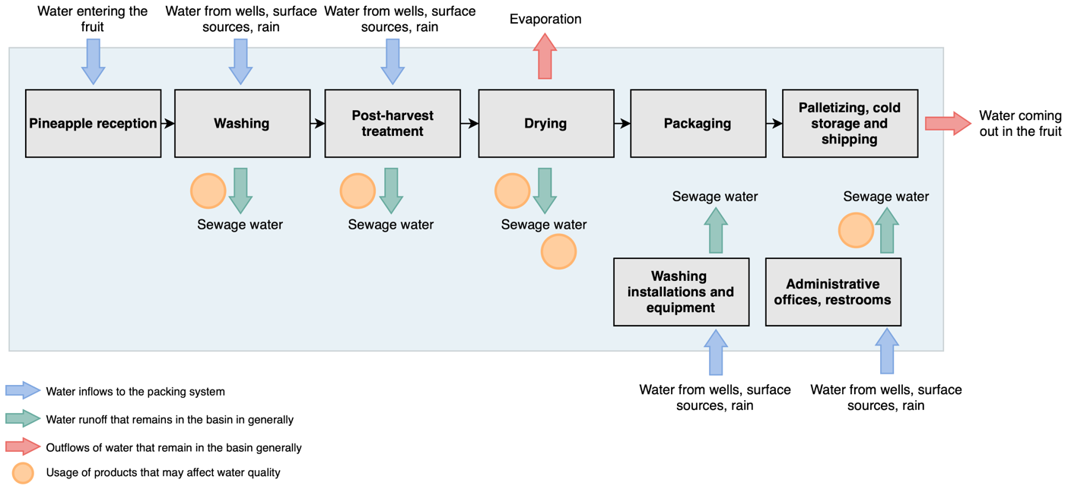
Identification of water balance and use of products
Identification of water balance and use of products at the packing stage

Slide 15
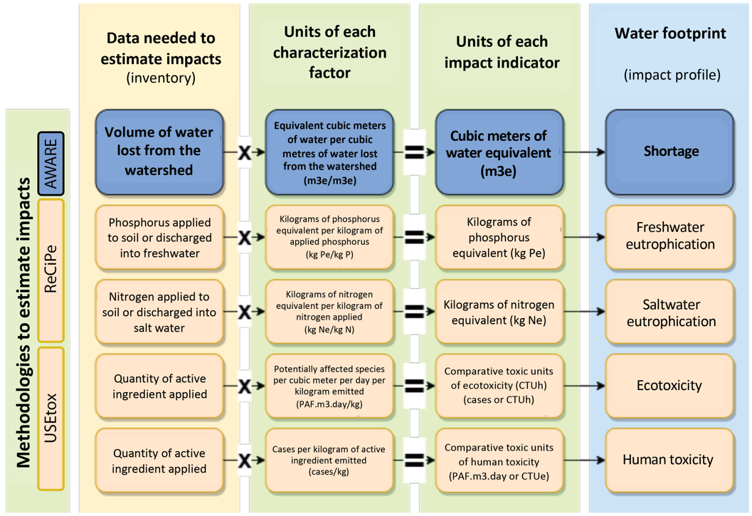
Assessment of water footprint impact
After collecting the information for the water footprint inventory, we will proceed to estimate the potential water footprint impacts.
Note: Blue shows the indicator related to consumptive use and orange shows those associated with degradative uses. AWARE=Available WAter Remaining.

Slide 16
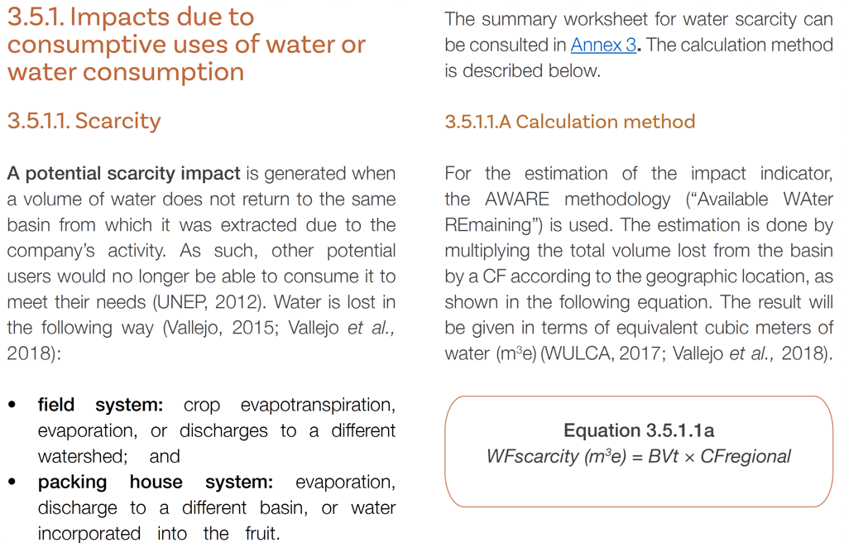
Assessment of water footprint impact (continued)
The water footprint measurement guide provides guidance for assessing potential impacts and the corresponding calculation methodologies.
For example:

Slide 17
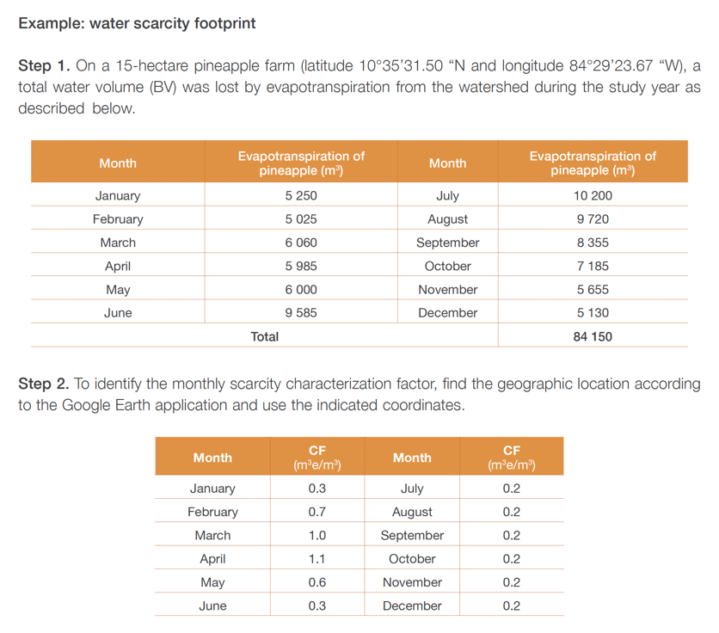
Assessment of water footprint impact (continued)
An example calculation is provided for each impact, to guide the user in the application of the methodology.

Slide 18
Water footprint report
Once the potential water footprint impacts have been assessed, it is recommended to consolidate the results into a water footprint profile.
For example:
Water footprint profile
Impact | Field | Packing house | Total
Shortage (m³e)
Freshwater eutrophication (kg Pe)
Saltwater eutrophication (kg Ne)
Ecotoxicity (CTUe)
Human toxicity (CTUh)

Slide 19
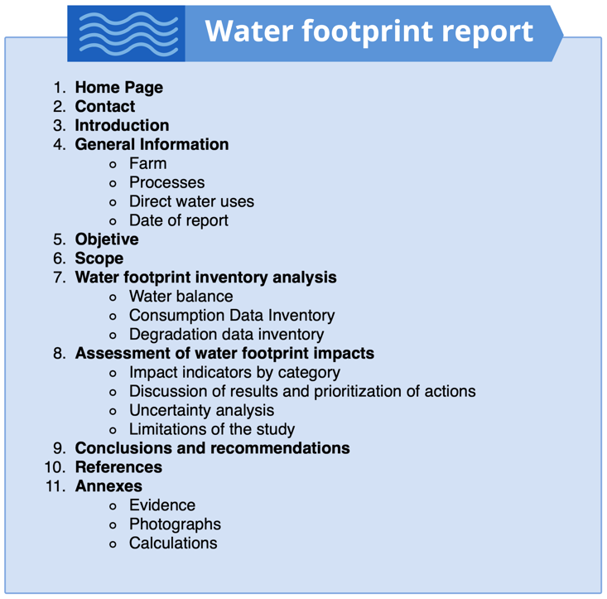
Water footprint report (continued)
The results of the water footprint inventory are generally presented in a report , which is recommended to contain at least the following points:

Slide 20
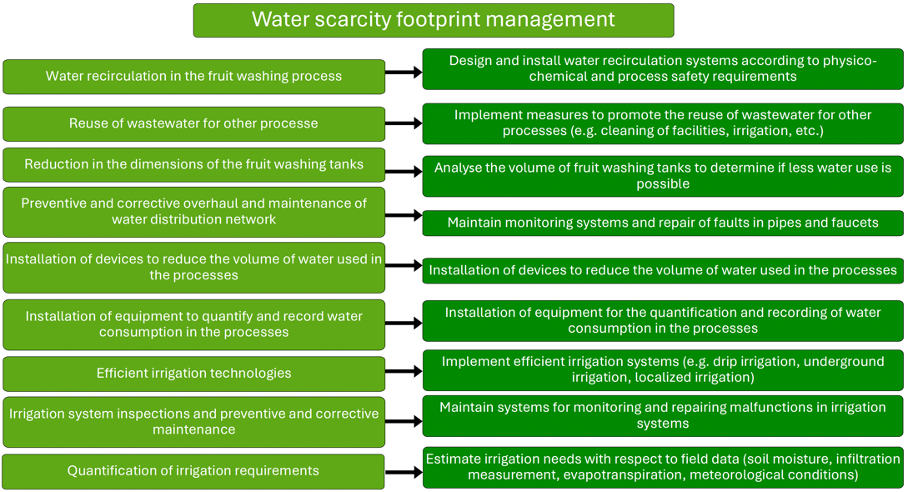
Water footprint reduction measures
The water footprint indicator, having a life cycle analysis approach, is expressed by a set of potential impacts on different aspects associated with water resources.
When thinking about options for reducing the footprint, the company must visualize all the good and best practices available within the sector to make a more efficient use of water and reduce the use of substances or activities that affect water quality.

Slide 21
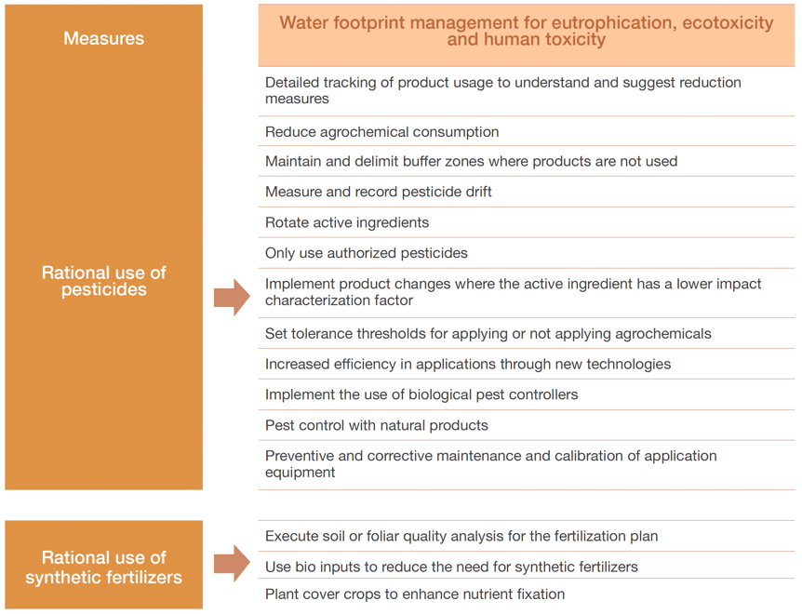
Water footprint reduction measures (continued)
Examples of water footprint reduction measures due to human toxicity, ecotoxicity and eutrophication.

Slide 22
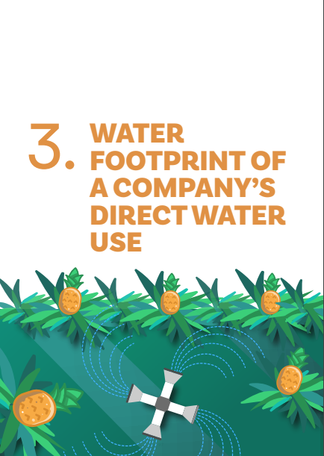
Advantages of using the water footprint measurement guide in the pineapple value chain
Provides a detailed guidance for the development of the water footprint in the sector.
It contains case examples for the application of the calculation methodologies for each potential water footprint impact.
It is the first water footprint measurement guide oriented to the pineapple value chain.

Slide 23


Thank you!
https://bit.ly/responsible-fruits
Responsible-Fruits@fao.org

